Slide 1
PRE-HISTORICAL AGE
Presented By:Professor Nissar Ahmad Kumar
Department of History
Govt Degree College Boys Anantnag

Slide 2
Prehistory
An Overview

Slide 3
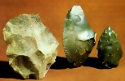
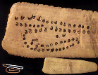
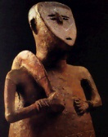
The prehistoric period
c. 4.5 MYA-3700 BCE
Major accomplishments
Tool manufacture and use
Communication
Verbal
Written?
Domestication of animals
And plants?
Finally: agriculture
The “First Wave”

Slide 4
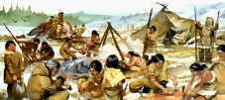
The Paleolithic period
“old stone age”
c. 500,000 BCE - c. 6000 BCE
Basic features
Hunting and gathering
Remarkable art (and religion?)
Simple tools of chipped stone
Simple shelters
Fire
c. 150,000 BCE?
Language

Slide 5
The Neolithic period
Began in Middle East around 6000 BCE
to c. 3700 BCE
Basic features
Food production
Polished stone tools
and weapons?
More settled, less nomadic lifestyles
“permanent” villages
Population increases
Development of a more complex (and satisfying?) social order

Slide 6
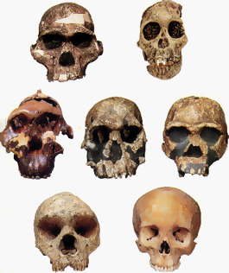
Human evolution

Slide 7
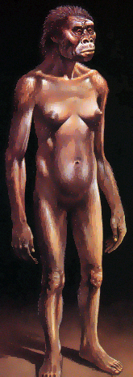
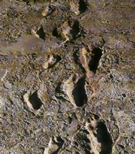
The Australopithecines
“Lucy”

Slide 8
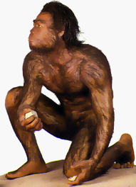
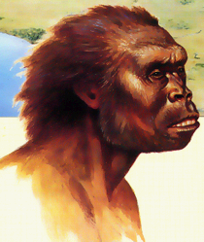
Homo habilis
“Handy Man”

Slide 9
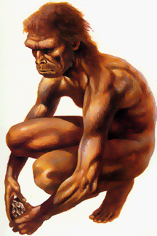
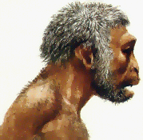
Homo erectus

Slide 10
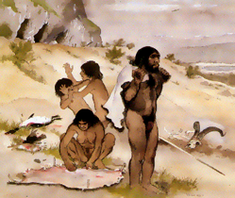
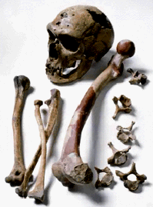
The mysterious Neanderthal
The subject of one of prehistory’s most intriguing questions

Slide 11
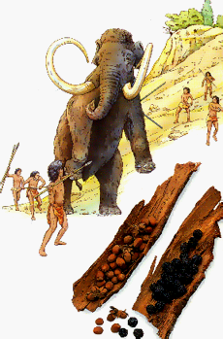
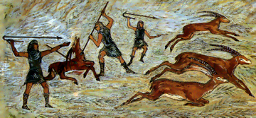
Eating
Who was the more productive?
The hunter?
Or the gatherer?

Slide 12
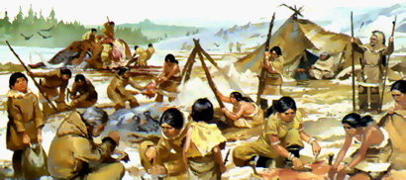
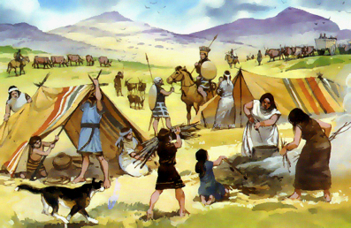
The peripatetic life
c
Social scenes

Slide 13
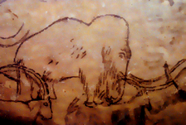
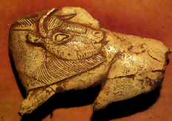
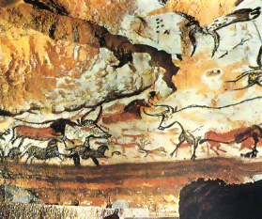
Extraordinary art!

Slide 14
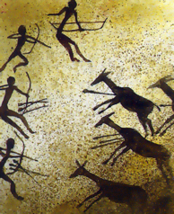
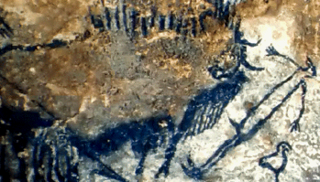
Cave art (cont.)
What general theme is evident here?

Slide 15
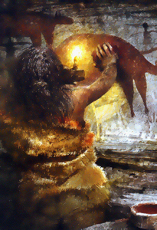
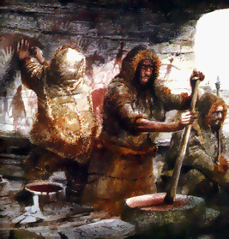
Cave artists

Slide 16
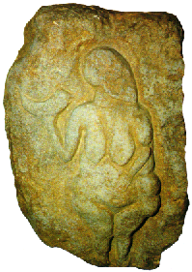
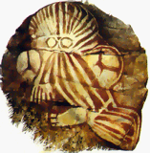
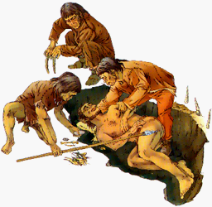
Paleolithic religion?

Slide 17
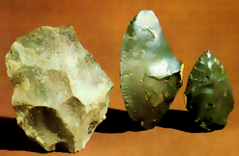
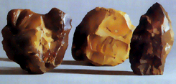
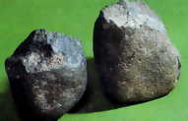
Homo faber
Early stone tools
A. Homo habilis
B. Homo erectus
C. Neanderthal
C.
A.
B.

Slide 18
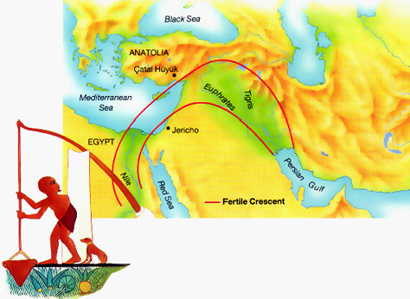
The Fertile Crescent
shaduf

Slide 19
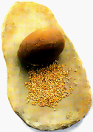
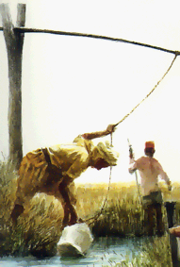
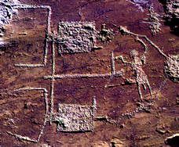
Farming

Slide 20
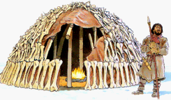
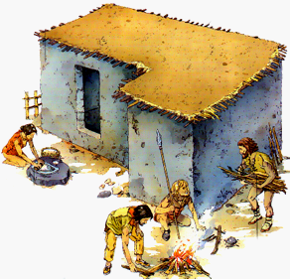
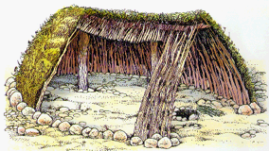
Settling down
Prerequisite to civilization

Slide 21
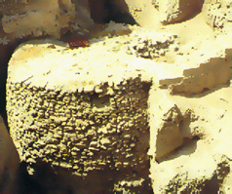
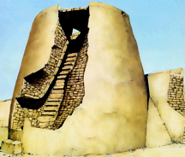
Jericho
Jordan River valley
c. 8000 BCE

Slide 22
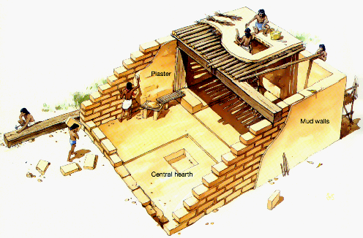
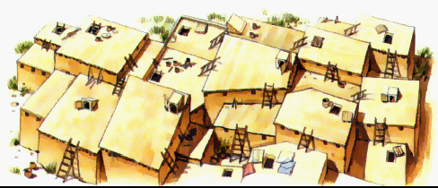
Catal Hüyük
Modern Turkey
c. 6500 BCE

Slide 23
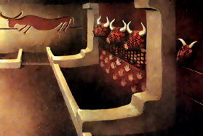
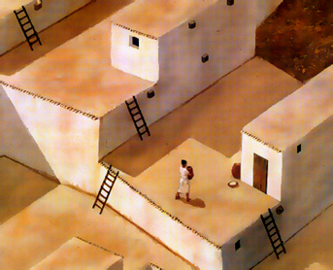
Catal Hüyük (cont.)

Slide 24
The first writing?
Symbolic writing

Slide 25
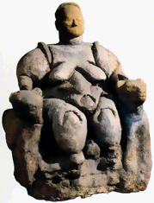
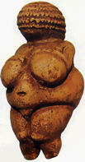
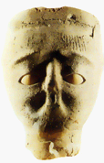
Neolithic religious life
Beliefs

